Slide 1
Game Theory
Nash equilibrium
Stackelberg games

Slide 2
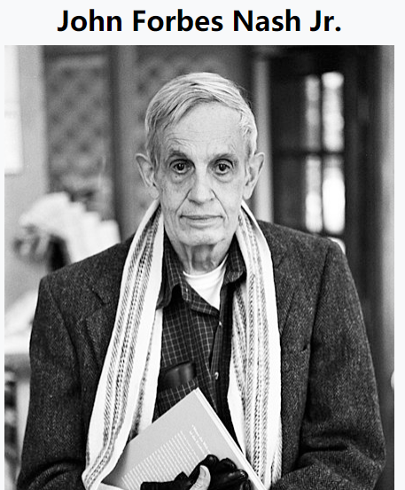
Nash equilibrium
What’s Nash equilibrium?
a proposed solution of a non-cooperative game involving two or more players.
In terms of game theory, if each player has chosen a strategy, and no player can benefit by changing strategies while the other players keep theirs unchanged, then the current set of strategy choices and their corresponding payoffs constitutes a Nash equilibrium.

Slide 3

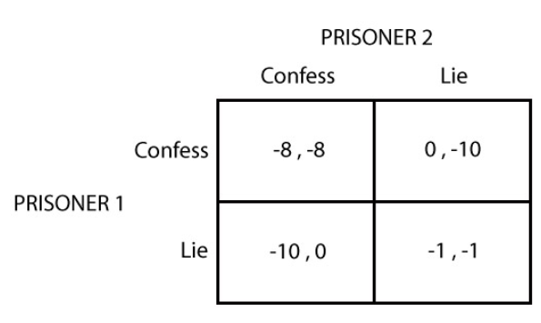
Nash equilibrium
Prisoner's dilemma
The prisoner's dilemma has a single Nash equilibrium: both players choosing to confess.

Slide 4
Nash equilibrium
Nash showed that there is a Nash equilibrium for every finite game
“ﬁnite” means two things: ﬁnite set of players and each of them has ﬁnite set of strategies
Nash equilibria can be used to predict the outcome of finite games, Furthermore, the best equilibrium outcome can be found by using the method of elimination of dominated strategies.

Slide 5
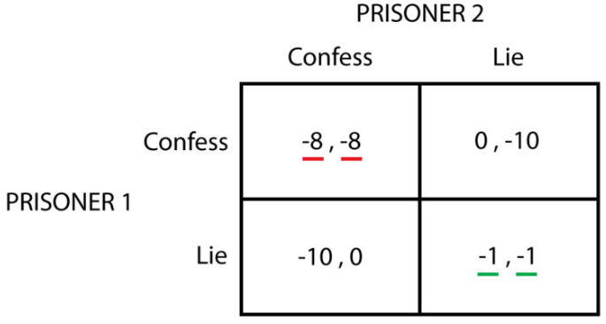
Nash equilibrium
Dominant strategies
Dominant strategies are considered as better than other strategies, no matter what other players might do.
-a strictly dominant strategy is that strategy that always provides greater utility to a the player, no matter what the other player’s strategy is; >
-a weakly dominant strategy is that strategy that provides at least the same utility for all the other player’s strategies, and strictly greater for some strategy. >=
Dominant strategy equilibrium

Slide 6
Nash equilibrium
The elimination of dominated strategies
The way to proceed is to eliminate for each player every strategy that seems ‘unreasonable’, which will greatly reduce the number of equilibria.
This method is quite easy to use when only strictly dominated strategies are in place,
but the elimination of weakly dominated strategies can turn problematic, ending up with a game that does not resembles the original one from a strategic point of view.

Slide 7
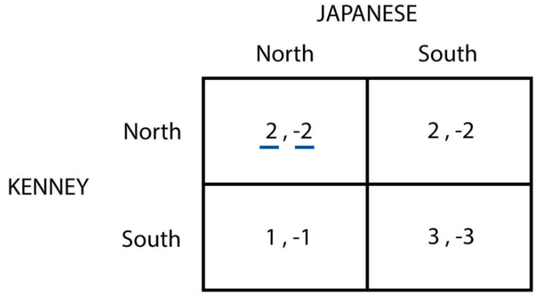
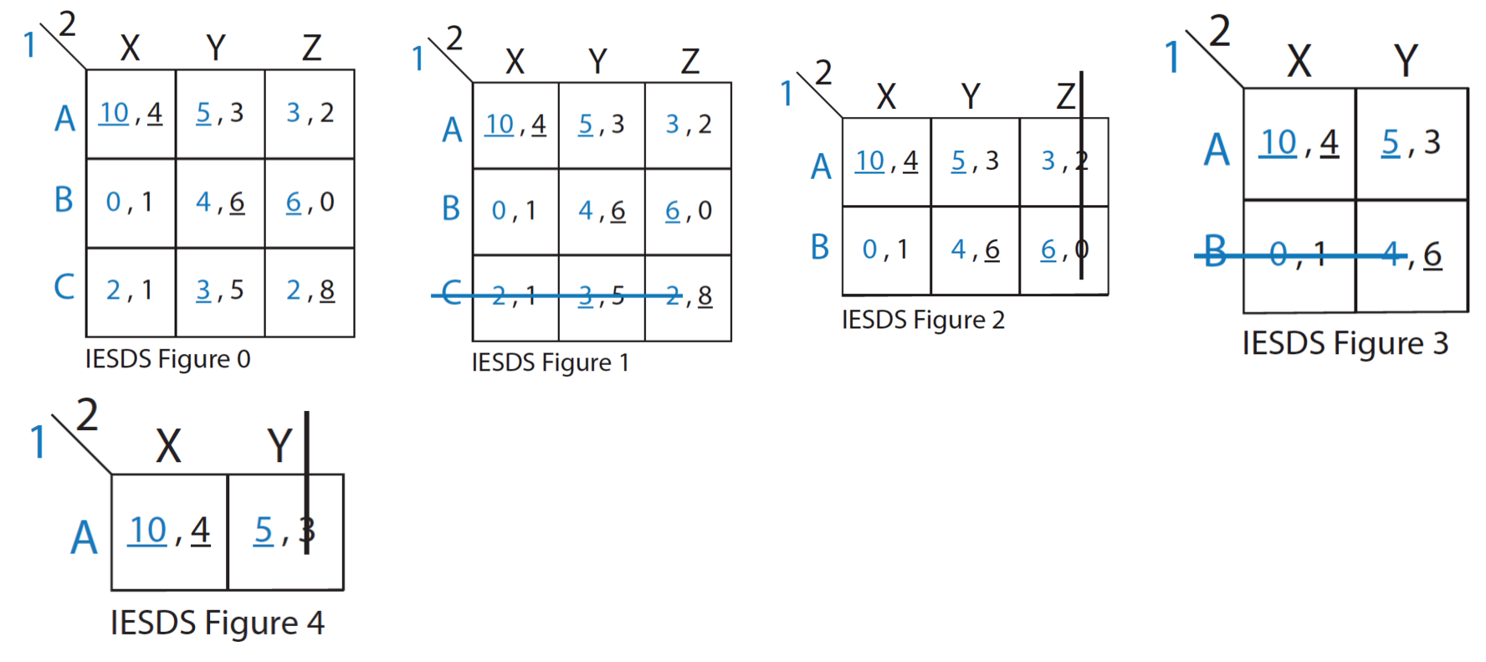
Nash equilibrium
the Battle of the Bismarck Sea

Slide 8
Stackelberg games
In a Stackelberg game, one player (the “leader”) moves first,
and all other players (the “followers”) move after him.

Slide 9
Stackelberg competition
Two firms (N = 2)
Each firm chooses a quantity s_{n} ≥ 0
Cost of producing s_{n} : c_{n} s_{n}
Demand curve:
Price = P(s₁ + s₂) = a – b (s₁ + s₂)
Payoffs:
Profit = Π_{n}(s₁, s₂) = P(s₁ + s₂) s_{n} – c_{n} s_{n}

Slide 10
Stackelberg competition
In Stackelberg competition, firm 1 moves before firm 2.
Firm 2 observes firm 1’s quantity choice s₁, then chooses s₂.

Slide 11
Stackelberg competition
We solve the game using
backward induction.
Start with second stage:
Given s₁, firm 2 chooses s₂ as
s₂ = arg max_{s2 ∈ S2} Π₂(s₁, s₂)
But this is just the best response R₂(s₁)!

Slide 12
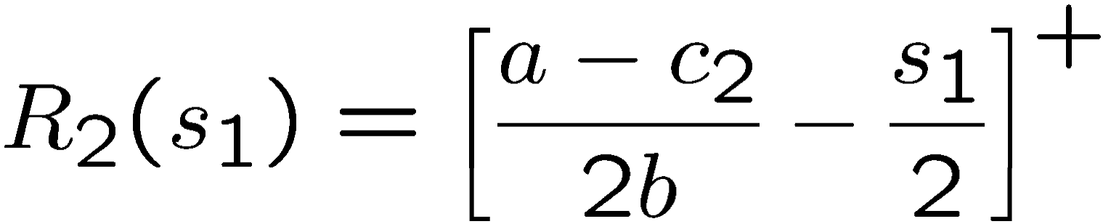
Best response for firm 2
Recall the best response given s₁:
Differentiate and solve:
So:

Slide 13
Firm 1’s decision
Backward induction:
Maximize firm 1’s decision, accounting for firm 2’s response at stage 2.
Thus firm 1 chooses s₁ as
s₁ = arg max_{s1 ∈ S1} Π₁(s₁, R₂(s₁))

Slide 14
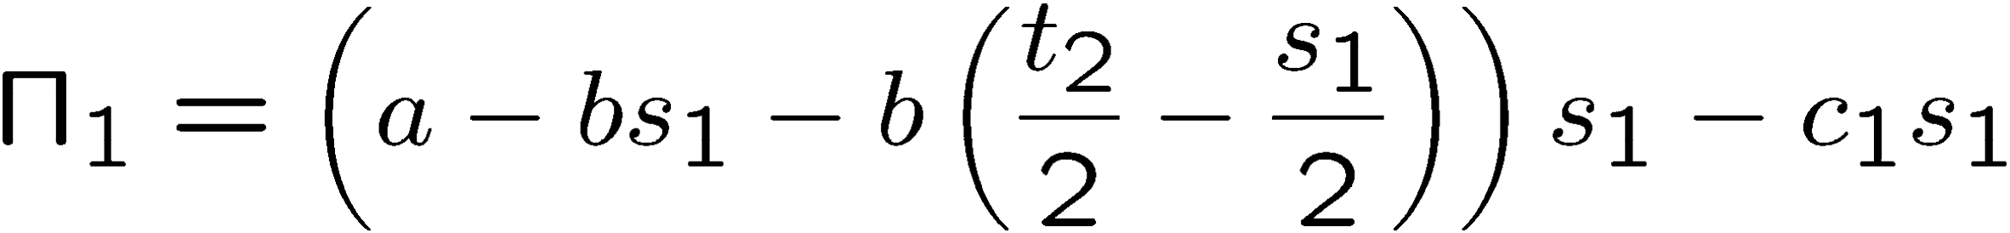
Firm 1’s decision
Define t_{n} = (a - c_{n})/b.
If s₁ ≤ t₂, then payoff to firm 1 is:
If s₁ > t₂, then payoff to firm 1 is:

Slide 15
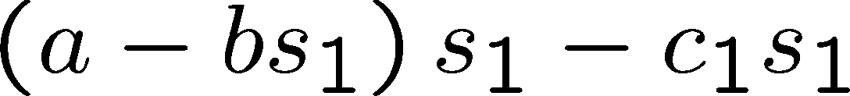
Firm 1’s decision
For simplicity, we assume that 2c₂ ≤ a + c₁
This assumption ensures that
is strictly decreasing for s₁ > t₂.
Thus firm 1’s optimal s₁ must lie in [0, t₂].

Slide 16

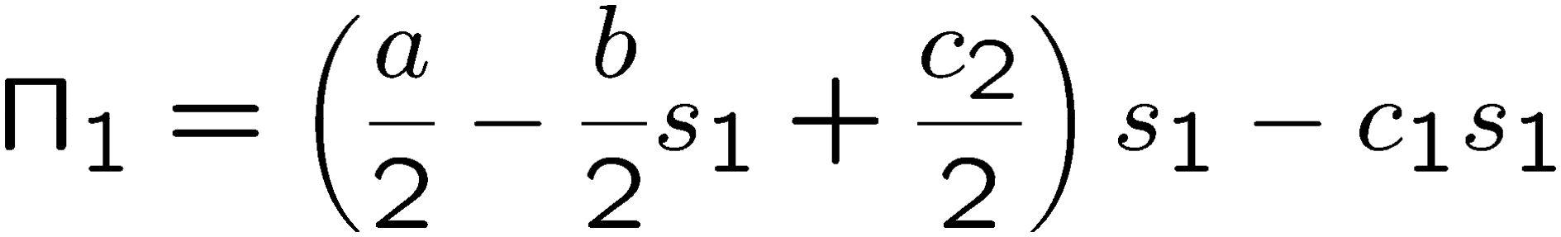
Firm 1’s decision
If s₁ ≤ t₂, then payoff to firm 1 is:

Slide 17
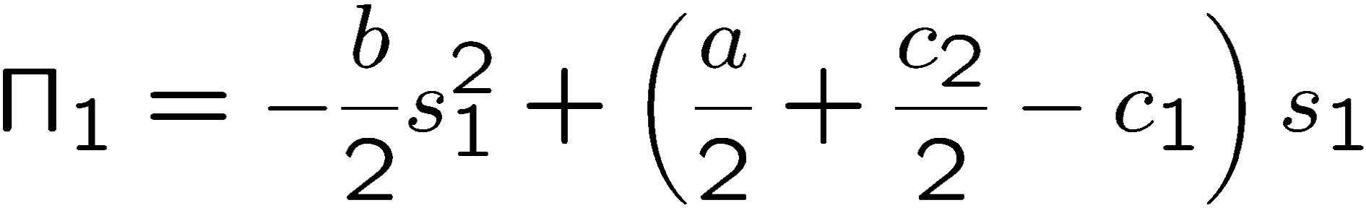
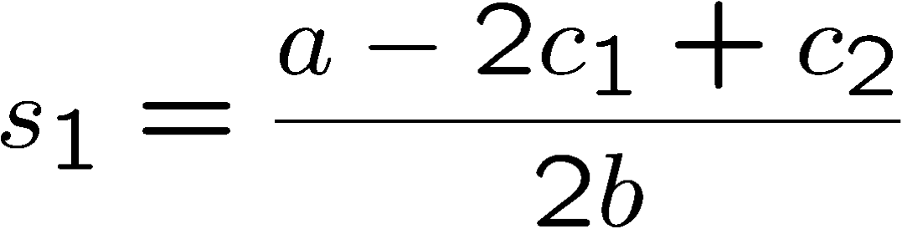
Firm 1’s decision
If s₁ ≤ t₂, then payoff to firm 1 is:
Thus optimal s₁ is:

Slide 18
Stackelberg equilibrium
So what is the Stackelberg equilibrium?
Must give complete strategies:
s₁* = (a - 2c₁ + c₂)/2b s₂*(s₁) = (t₂/2 - s₁/2)⁺
The equilibrium outcome is that
firm 1 plays s₁*, and firm 2 plays s₂*(s₁*).

Slide 19
Comparison to Cournot
Assume c₁ = c₂ = c.
In Cournot equilibrium: (1) s₁ = s₂ = t/3.
(2) Π₁ = Π₂ = (a - c)²/(9b).
In Stackelberg equilibrium: (1) s₁ = t/2, s₂ = t/4.
(2) Π₁ = (a - c)²/(8b), Π₂ = (a - c)²/(16b)

Slide 20
Comparison to Cournot
So in Stackelberg competition:
-the leader has higher profits
-the follower has lower profits
This is called a first mover advantage.

Slide 21
Stackelberg competition: moral
Moral:
Additional information available can lower a player’s payoff,
if it is common knowledge that the player will have the additional information.
(Here: firm 1 takes advantage of knowing firm 2 knows s₁.)

